Slide 1
SQL REINFORCEMENT PROJECT
Anupriya.c
DA&DS OCTOBER BATCH

Slide 2
INTRODUCTION
IMDB DATASET
DIRECTOR_MAPPING
GENRE
MOVIE
NAMES
RATINGS
ROLE_MAPPING

Slide 3
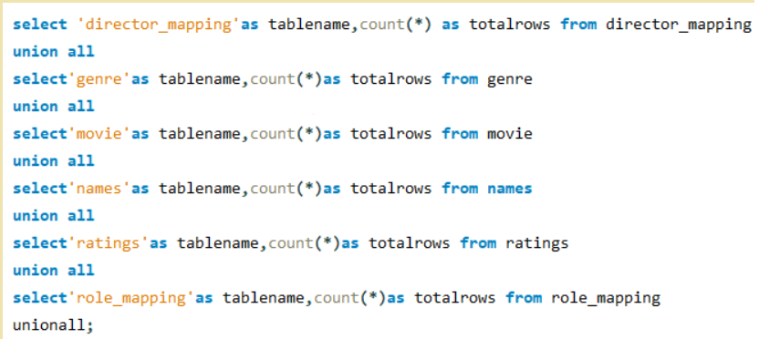
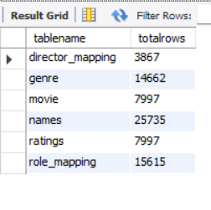
1.Find the total number of rows in each table of the schema ?

Slide 4
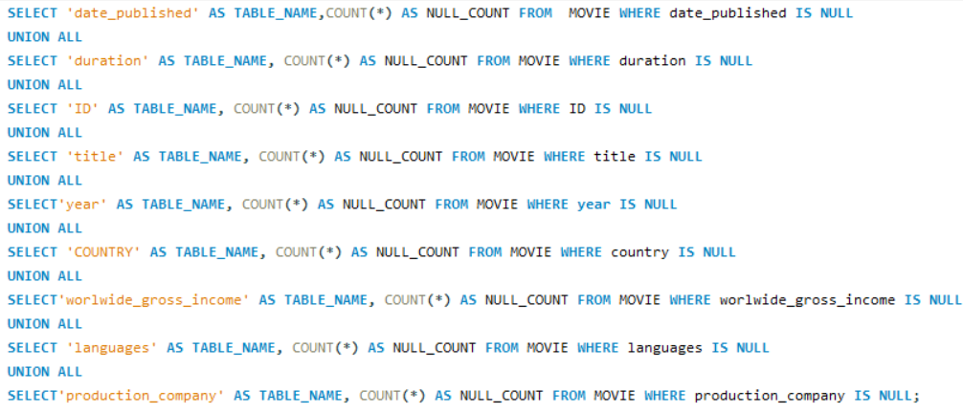
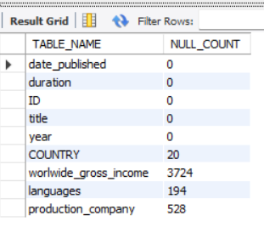
2. Which columns in the movie table have null values ?

Slide 5
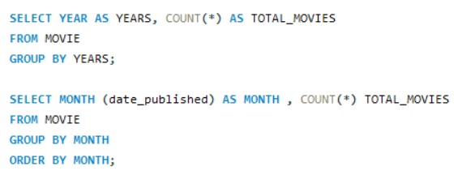
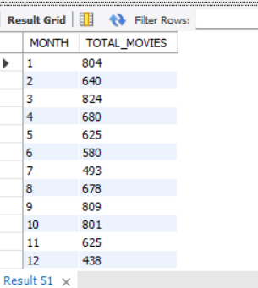
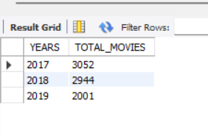
3.Find the total number of movies released each year. How does the trend look-month wise?

Slide 6
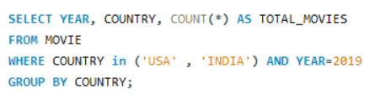
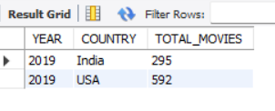
4. How many movies were produced in the USA or India in the year 2019?

Slide 7
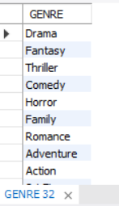
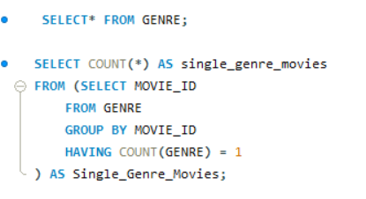
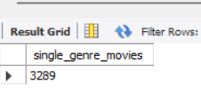
5. Find the unique list of genres present in the dataset and how many movies belong to only one genre ?

Slide 8
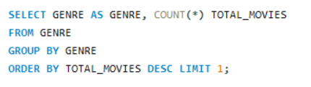
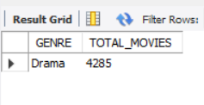
6. Which genre had the highest number of movies produced overall ?

Slide 9
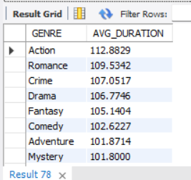
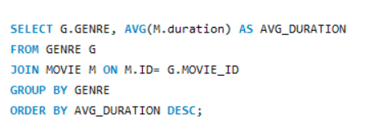
7. What is the average duration of movies in each genre ?

Slide 10
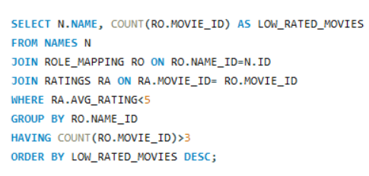
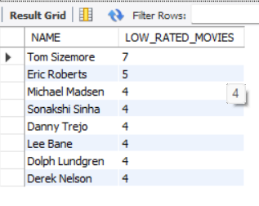
8. Identify actors or actresses who have worked in more than three movies with an average rating below 5

Slide 11
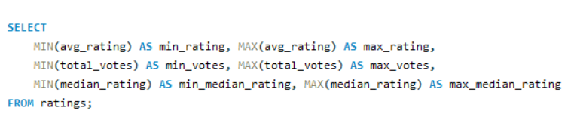

9. Find the minimum and maximum values in each column of the ratings table except the movie - id column

Slide 12
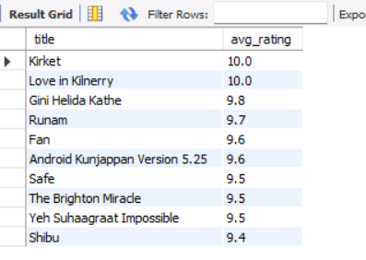
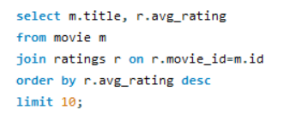
10.Which are the top 10 movies based on average rating

Slide 13
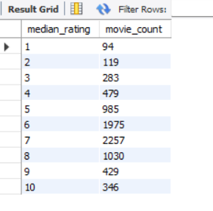
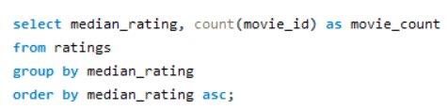
11.Summarise the ratings table based on the movie counts by median ratings

Slide 14
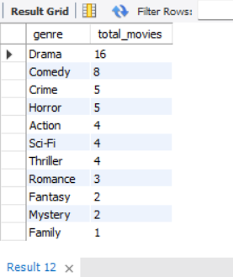
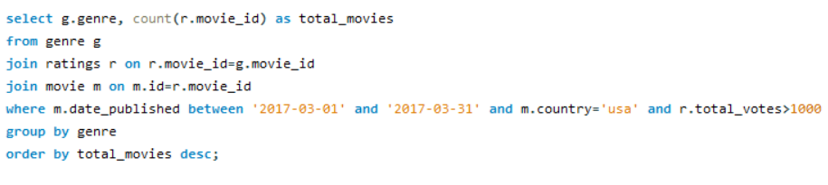
12.How many movies released in each genre during March 2017 in the USA had more than 1,000 votes

Slide 15
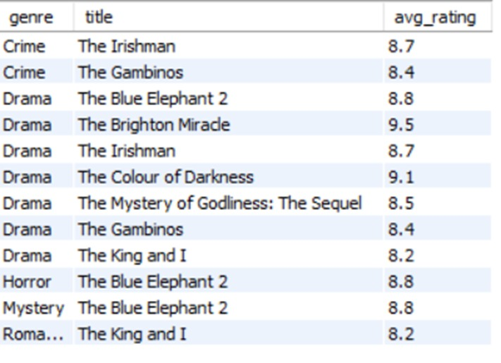
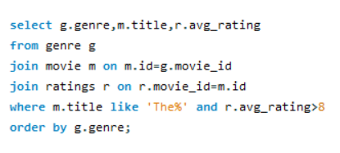
13. Find movies of each genre that start with the word ‘The’ and which have an average rating > 8.

Slide 16
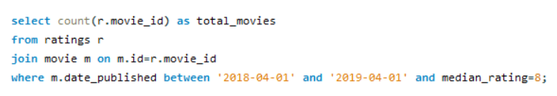
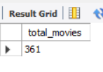
14. Of the movies released between 1 April 2018 and 1 April 2019, how many were given a median rating of 8

Slide 17
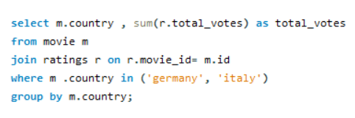
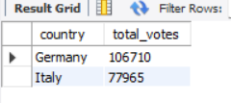
15.Do German movies get more votes than Italian movies

Slide 18
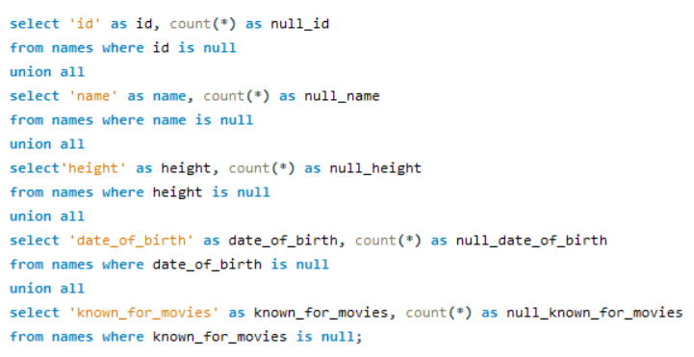
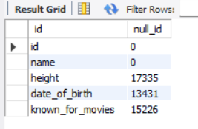
16.Which columns in the names table have null values

Slide 19
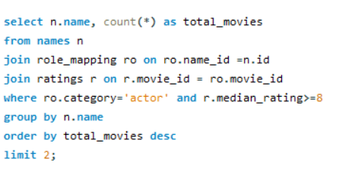

17.Who are the top two actors whose movies have a median rating >= 8

Slide 20
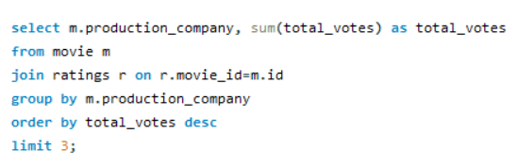
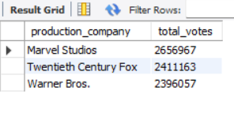
18.Which are the top three production houses based on the number of votes received by their movies

Slide 21
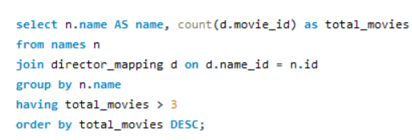
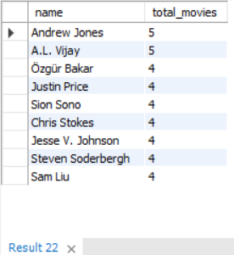
19.How many directors worked on more than three movies

Slide 22
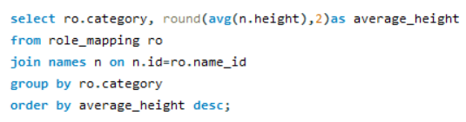
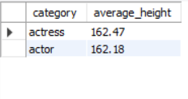
20.Find the average height of actors and actresses separately

Slide 23
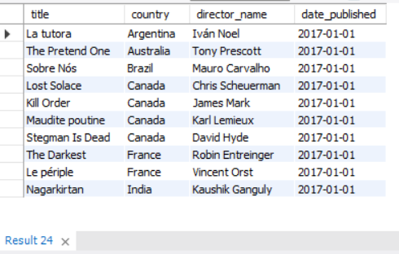
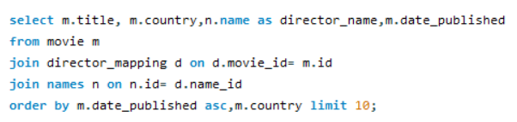
21.Identify the 10 oldest movies in the dataset along with its title, country, and director

Slide 24
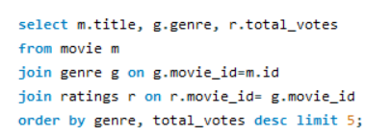
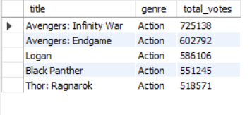
22. List the top 5 movies with the highest total votes and their genres

Slide 25
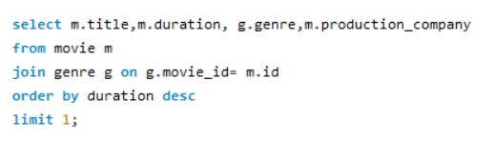

23. Find the movie with the longest duration, along with its genre and production company

Slide 26
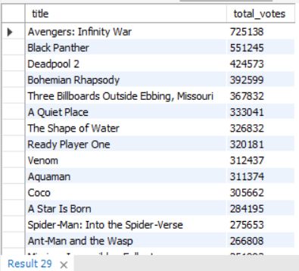
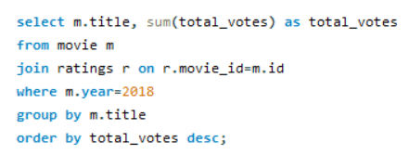
24. Determine the total votes received for each movie released in 2018

Slide 27
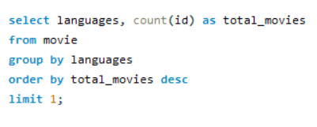

25. Find the most common language in which movies were produced

Slide 28
INSIGHTS AND CONCLUSION
HIGHEST MOVIE RELEASED YEAR-2017
HIGHEST MOVIE PRODUCED MONTH- MARCH
LOWEST MOVIE PRODUCED MONTH - DECEMBER IN 2019
MOST USED LANGUAGE - ENGLISH
MORE VOTES COLLECTED GENRE – ACTION
HIGHEST GENRE - DRAMA
LOWEST GENRE - FAMILY

Slide 29
Thank you

